Slide 1

KNOWING YOUR CUSTOMERS: HOW TO DIVIDE AND CONQUER THE MARKET

Slide 2

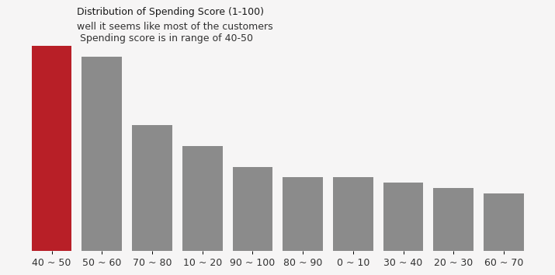
DEMOGRAPHICS
Demographic information such as age, gender, income, and education can help you create customer proﬁles. This information can be used to tailor your marketing efforts
to each group and ensure that your message resonates with them.

Slide 3

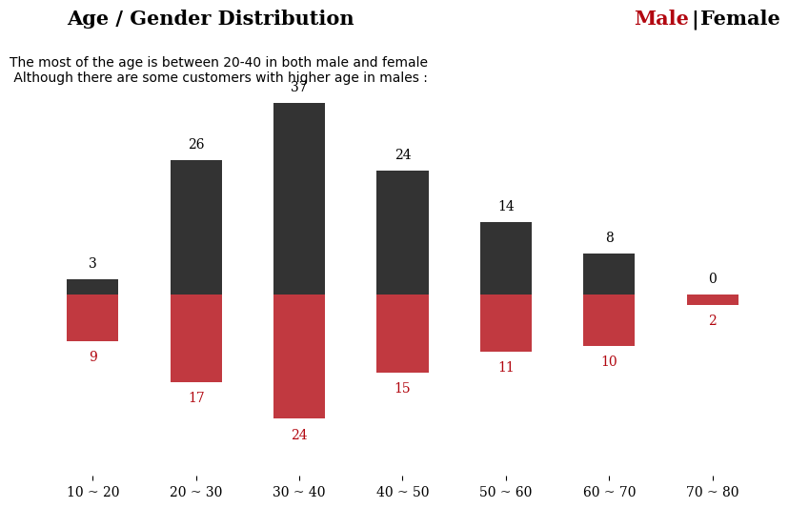

SEGMENTATION
Market segmentation is the process of dividing customers into groups based on similar needs and characteristics. This helps you tailor your marketing efforts to each group, leading to better customer satisfaction and sales.

Slide 4


KNOWING YOUR CUSTOMERS
Understanding your customers is an essential part of any marketing strategy. By dividing your market into speciﬁc groups, you can conquer each segment effectively.

Slide 5

BENEFITS
By knowing your customers and their speciﬁc needs, you can create products and services that are tailored to each group. This leads to better customer satisfaction, increased brand loyalty, and higher sales.

Slide 6

CONCLUSION
By dividing and conquering your market, you can create targeted marketing campaigns that resonate with each customer group. This leads to better customer satisfaction, increased brand loyalty, and higher sales. So take the time to get to know your customers and reap the rewards!

Slide 7

THANK YOU

